Slide 1


JAVA INTERVIEW BOOTCAMP ADVANCE CONCEPTS
Lecture 17
Advance Concepts In OOP

Slide 2
CHAPTER 17
OOPs & Advanced OOPs
Topics Covered
OOP Basics
Encapsulation
Inheritance & Advance Concepts
Polymorphism & Advance Concepts

Slide 3
What is OOP?
A programming paradigm which is based on real world model of objects or entities.
It is organized around objects rather than "actions" and data rather than “logic”.
Object-oriented programming takes the view that what we really care about are the objects we want to manipulate rather than the logic required to manipulate them.

Slide 4
Important Terminologies Of OOPs
Object
Class
Abstraction
Encapsulation
Polymorphism
Inheritance
Composition

Slide 5
Object
Any real world entity which is composed of some characteristics and behavior .
The characteristics are related to the “Data” and behavior to the “Operation”.

Slide 6
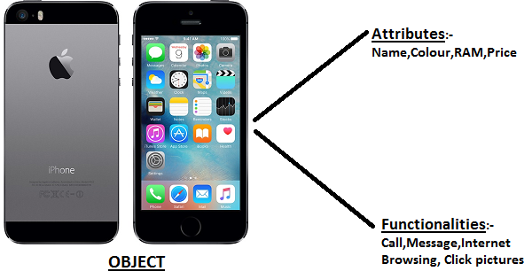
Example

Slide 7
Class
In Object Oriented Programming, a Class is a blueprint for an object.
In fact, classes describe the type of objects, while objects are usable instances of classes.
Each Object is built from the same set of blueprints and therefore contains the same components (properties and methods).

Slide 8



Example
Mobile Phones
Class
Objects
Samsung
Nokia
iPhone

Slide 9
Syntax Of Creating A Class In Java
[access modifier] | [non-access modifiers] class <classname>
{
[access modifier] | [non-access modifiers] <data type> <var_name>=[value];
.
.
[access modifier] | [non-access modifiers] <return type> <method>(<arg>)
{
// method body
}
.
.
}

Slide 10
Example Of Creating A Class In Java
class Student
{
private int roll;
private String name;
private double per;
public void setData(int r,String s,double p)
{
roll=r;
name=s;
per=p;
}

Slide 11
Example Of Creating A Class In Java
public void showData()
{
System.out.println(“Roll= “+roll);
System.out.println(“Name=“+name);
System.out.println(“Per=“+per);
}
}

Slide 12
Syntax Of Instantiating A Class
To create objects of a class we follow a two step
procedure in java:
Declaring object reference
<classname> <object_ref>;
Creating object and assigning it to object reference
<object_ref>=new <classname>( );

Slide 13
Example Of Instantiating A Class
Student s;
s=new Student( );
OR
Student s=new Student( );

Slide 14
Popular Interview Question
Qn. In how many ways can you create object of a class ?
Ans: In 5 ways:
Using new keyword
Using newInstance() method of class Class
Using Constructor class
Using clone() method of Object class
Using Deserialization

Slide 15
Popular Interview Question
Qn. What’s the difference in these ways ?
Ans: In first 3 approaches constructor of the class getting instantiated will be called , while in the last 2 ways no constructor calling will be done.

Slide 16
Creating Object Using newInstance()
The newInstance() method belongs to the class Class
and has the following prototype:
public T newInstance() throws InstantiationException,
IllegalAccessException
Sample Code:
Class c=Class.forName("Person");
Person p=(Person)c.newInstance();

Slide 17
Creating Object Using newInstance()
Another Way:
Sample Code:
Class c=Person.class;
Person p=(Person)c.newInstance();

Slide 18
Creating Object Using Constructor class
There is another newInstance() method which belongs to
the class java.lang.reflect.Constructor and has the following
prototype:
public T newInstance(Object … values) throws InstantiationException,
IllegalAccessException,IllegalArgumentException,
InvocationTargetException
Sample Code:
Constructor c=Person.class.getConstructor();
Person p=(Person)c.newInstance();

Slide 19
The Difference In Both newInstance()
The newInstance() method of Class class can invoke only no-arg
constructor of the class when a class has parameterized
constructors we cannot use newInstance() method of Class class
at that place we need to go for the newInstance() method of
the Constructor class:
Sample Code:
Constructor c=Person.class.getConstructor(int.class,String.class);
Person p=(Person)c.newInstance(25,”Amit”);

Slide 20
What Benefit We Get With newInstance() Compared With new ?
Allows us to create objects at runtime
It is the way many frameworks like Spring and Hibernate create objects for us.
Helps us implement Factory Pattern in a more clean way

Slide 21
What Happens In Memory When An Object Is Created ?
Whenever we create an object in java then
following actions are taken:
1. The operator new allocates space for the object with it’s instance members in a memory area called heap.

Slide 22
What Happens In Memory When An Object Is Created ?
2. Then these instance members are initialized with their default values which are as below:
Type | Default Value
int,short,long,byte,float,double | 0 and 0.0
char | ‘\u0000’ or ‘\0’
boolean | false
object or array reference | null

Slide 23
What Happens In Memory When An Object Is Created ?
After initializing object with default values , java calls appropriate constructor of the class
The constructor initializes the object with proper data
Then finally new returns the address of the object which gets stored in the reference

Slide 24
What Happens In Memory When An Object Is Created ?
This is heap
1000
0
null
0.0
roll
name
per
This is stack
1000
s

Slide 25
Syntax Of Calling Class Methods
To call a class method we use object reference
followed by .(dot) operator and method name
<object reference>. <method_name>( );

Slide 26
Syntax Of Calling Class Methods
s.setData(10,”Amit”,78.2);
s.showData( );

Slide 27
Complete Code
class Student
{
private int roll;
private String name;
private double per;
public void setData(int r,String s,double p)
{
roll=r;
name=s;
per=p;
}

Slide 28
Complete Code
public void showData()
{
System.out.println(“Roll= “+roll);
System.out.println(“Name=“+name);
System.out.println(“Per=“+per);
}
}

Slide 29
Complete Code
class UseStudent
{
public static void main(String [ ] args)
{
Student s;
s=new Student( );
s.setData(10,”Amit”,78.2);
s.showData( );
}
}

Slide 30
What Elements A Java Class Can Contain ?
A java class can have following elements:
Instance Fields(variables declared at class level)
Static Fields
Instance Methods
Static Methods
Constructors
Initializer blocks(instance initializer and static initializer)
Nested/Inner Classes
Nested Interface
Important For Interview
Important For learning Modern Java features

Slide 31
Pillars Of OOPs
Abstraction and Encapsulation
Object Oriented Programming
Inheritance
Polymorphism

Slide 32

Abstraction and Encapsulation
Abstraction : Focus on the meaning i.e. Suppress irrelevant “implementation” details.
Encapsulation is a process of binding or wrapping the data and the codes that operates on the data into a single entity.
Abstraction and Encapsulation go hand in hand.

Slide 33
How To Achieve Encapsulation ?
To achieve “Encapsulation” , we take 2 steps:
Keep the instance variables private (or protected).
Provide proper setter and getter methods in the class to operate on these members.
getter , setter are also called as “accessor” and “mutator” respectively.

Slide 34
EXAMPLE
public class Person{ private String name; private int age; public void setName(String name){ this.name=name; } public String getName(){ return name; }

Slide 35
EXAMPLE
public void setAge(int age){ this.age=age; } public int getAge(){ return age;
}
}

Slide 36
Advantages Of Encapsulation
Encapsulated code is more flexible.
Encapsulation makes unit testing easy.
The fields can be made read-only

Slide 37
Object Initialization
In Java to initialize an object we have 3 options:
Explicit initialization.
Using constructors
Using initializer blocks.

Slide 38
Explicit Initialization
Java permits us to initialize members of the class at the point of their declaration and such way of initialization is known as Explicit initialization.
C++ considers this way as error, but in Java this is considered the fastest way of initialization.
This is preferred when all objects should have the same value at initialization.
Let us take an example of a class named Account.

Slide 39
Explicit Initialization
class Account
{
private int id=101;
private String name=“AMIT”;
private double balance=50000.0;
public void show( )
{
S.O.P(id+“\n”+name+“\n”+balance);
}
}
class UseAccount
{
public static void main(String [ ] args)
{
Account A;
A=new Account( );
A.show( );
}
}
1000
101
2000
50000
1000
“A M I T”
A
2000

Slide 40
Constructors
class Account
{
private int accid;
private String name;
private double balance;
public Account()
{
accid=101;
name=“AMIT”
balance=50000.0;
}
public void show()
{
System.out.println(accid+”\n”+name+”\n”+balance);
}
}

Slide 41
Constructors
1000
101
2000
50000
0
0
0
class CreateAccount
{
public static void main(String [] args)
{
Account A;
A=new Account();
A.show();
}
}
1000
“A M I T”
2000
Constructor gets called

Slide 42
Creating Parameterized Constructors
It is same as creating a parameterized method, but while creating the object using new, programmer has to make sure that he passes those same parameters.
class Account
{
private int accid;
private String name;
private double balance;
public Account(int id, String s, double b)
{
accid=id;
name=n;
balance=b;
}

Slide 43
Creating Parameterized Constructors
public void show()
{
System.out.println(accid+”\n”+name+”\n”+balance);
}
}
class CreateAccount
{
public static void main(String [] args)
{
java.util.Scanner kb=new java.util.Scanner(System.in);
S.O.P(“Enter Account id, name and balance”);
int id=kb.nextInt();
String name=kb.nextLine();
double balance=kb.nextDouble();
Account A;
A=new Account(id,name,balance);
A.show();
}
}

Slide 44
Initializer Blocks
In Java Instance initializer blocks are used to initialize instance data members or say objects.
It runs each time when an object of a class is created.
The whole block is copied inside each constructor of the class.
Syntax :-
class <classname>
{
<data member>;
// initializer block
{
// initializer body
}
}

Slide 45
Initializer Blocks
class Test
{
int x,y;
public Test( )
{
System.out.println(“In constructor with y= ”+y);
}
{
x=10;
System.out.println(“In initializer block with x= ”+x);
y=20;
}
}

Slide 46

Initializer Blocks
class TestDemo
{
public static void main(String [ ] args)
{
Test t1=new Test( );
Test t2=new Test( );
Test t3=new Test( );
}
}
What can you observe in this output???
The initializer blocks execute even before the constructor
body and executes every time an object of a class is
created.

Slide 47
Inheritance
Inheritance is the process of reusing properties of one class into another.
In simple words it means, creating new classes with some extra functionality from an existing class or interface.

Slide 48
class B extends A { ….. }
A super class
B sub class
A
<<class>>
<<class>>
B
A
<<interface>>
class B implements A { ….. }
A interface
B sub class
B
<<class>>

Slide 49
Various Forms of Inheritance
Single Inheritance
Hierarchical Inheritance
A
A
X
X
B
B
A
B
C
A
B
C
NOT SUPPORTED BY JAVA
MultiLevel Inheritance
Multiple Inheritance
SUPPORTED BY JAVA
A
A
A
B
A
B
B
B
C
C
C
C

Slide 50
Multiple Inheritance
Mulitiple Inheritance can be implemented by implementing multiple interfaces not by extending multiple classes
Example :
class Z extends A implements C , D
{ …………}
OK
class Z extends A ,B class Z extends A extends B
{ {
OR
} }
A
C
D
Z
WRONG
WRONG

Slide 51
Defining A Subclass
Syntax :
class <subclass name> extends <superclass name>
{
variable declarations;
method definitions;
}
Extends keyword signifies that properties of the super class are extended to sub class
If inheritance is not defined, the class extends a class called Object

Slide 52
The Object Class
Every class in Java is descended from the java.lang.Object class. If no inheritance is specified when a class is defined, the superclass of the class is Object.

Slide 53
Example
Person
- name: String
- dob: Date
public class Person
{
private String name;
private Date dob;
[...]
Employee
- employeeID: int
- salary: int
- startDate: Date
public class Employee extends Person
{
private int employeID;
private int salary;
private Date startDate;
[...]
Employee anEmployee = new Employee();

Slide 54
What really happens?
When an object is created using new, the JVM allocates enough memory to hold all its instance variables.
This includes all inherited instance variables
Person
- name: String
- dob: Date
Employee
name = “Rajat"
dob = Mar 15, 1978
employeeID = 37518
salary = 65000
startDate = Dec 15, 2000
is a kind of
Employee
- employeeID: int
- salary: int
- startDate: Date

Slide 55
Example
class Num
{
private int a;
private int b;
public void setData(int x,int y)
{
a=x;
b=y;
}

Slide 56
Example
public int getA()
{
return a;
}
public int getB()
{
return b;
}
}

Slide 57
Example
class AddNum extends Num
{
private int c;
public void add()
{
c=getA()+getB();
}

Slide 58
Example
public void show()
{
System.out.println("Nos are :"+getA()+","+getB());
System.out.println("Sum is "+c);
}
}

Slide 59
Example
class UseAddNum
{
public static void main(String args[])
{
AddNum obj=new AddNum();
obj.setData(10,20);
obj.add();
obj.show();
}
}

Slide 60
EXERCISE
WAP to create a class called “Circle” having a
data member called “radius” of type int and
appropriate setter and getter for radius.
Now a sub-class of “Circle” create a class
called “Sphere” having a method called volume( )
which calculates and returns volume of the
Sphere.
Note: Volume of Sphere is 4/3∏ r³

Slide 61
SOLUTION
import java.util.*;
class Circle
{
private int radius;
public void setRadius(int r)
{
radius=r;
}

Slide 62
SOLUTION
public int getRadius()
{
return radius;
}
}

Slide 63
SOLUTION
class Sphere extends Circle
{
public double volume()
{
double vol;
vol=4/3.0 * (Math.PI*Math.pow(getRadius(),3));
return vol;
}
}

Slide 64
SOLUTION
class UseSphere
{
public static void main(String args[])
{
Scanner kb=new Scanner(System.in);
System.out.println("Enter radius:");
int r=kb.nextInt();

Slide 65
SOLUTION
Sphere s=new Sphere();
s.setRadius(r);
System.out.println("Radius of Sphere is "+s.getRadius());
System.out.println("It's Volume is "+s.volume());
}
}

Slide 66
Using the keyword “super”
The keyword “super” is used by a derived class to explicitly refer members of it’s base class.
Using “super” becomes compulsory in two situations :
To call constructor of the super class
To access overridden methods

Slide 67
Constructor Calling In Inheritance
Rule 1. Constructor of Parent class always executes before the constructor of derived class.
Rule 2. If Parent class has a non parameterized constructor then nothing needs to be done by the derived class.
Rule 3. But if the Parent class constructor is parameterized then we have to explicitly call the constructor of Parent class from the constructor of derived class, using “super”

Slide 68
Constructor Calling Example
class Vehicle{
Vehicle(){
System.out.println("Vehicle is created");
}
}
class Car extends Vehicle{
Car(){
System.out.println(“Car is created");
}
}
class Test
{
public static void main(String args[]){
Car c=new Car( );
}
}
Output:
Vehicle is created
Car is created

Slide 69
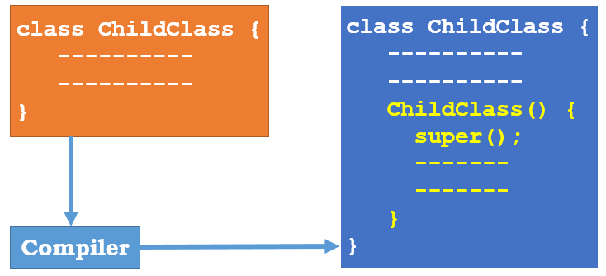
What compiler did ?

Slide 70
Is It Correct ?
class Apple
{
Apple()
{
super();
System.out.println(“Apple constructor !");
}
}

Slide 71
Parameterized Constructor In Inheritance
class A
{
private int x;
public A (int n)
{
x=n;
}
int getX( )
{
return x;
}
}

Slide 72
Parameterized Constructor In Inheritance
class B extends A
{
}
class Demo
{
public static void main(String[] args)
{
B obj=new B( );
}
}
WRONG!

Slide 73
Solution
class B extends A
{
public B( )
{
super(10);
}
}
class Demo
{
public static void main(String[] args)
{
B obj=new B( );
}
}

Slide 74
Two Very Important Rules Of Inheritance
Rule 1:
In java it is allowed for a super class reference to point
to the object of it’s derived class.
Example:
Circle c=new Sphere( );
However the reverse is not true.
Example:
Sphere s=new Circle( );
Correct!
Wrong!

Slide 75
Two Very Important Rules Of Inheritance
Rule 2:
A super class reference pointing to derive class object
can only access super class members but not derive
class members.
Example:
Circle c=new Sphere( );
System.out.println(“Radius:”+c.getRadius());
System.out.println(“Volume:”+c.volume());
Correct!
Wrong!

Slide 76
IS-A Relationships
In OO, the concept of IS-A is based on class inheritance or interface implementation.
IS-A is a way of saying, “This thing is a type of that thing.”
For example, Honda-Shine is a type of Bike, so in OO terms we can say, “Shine IS-A Bike” , “Swift IS-A Car” , “Potato IS-A Vegetable.”

Slide 77
IS-A Relationships
We express the IS-A relationship in Java through the keywords extends (for class inheritance) and implements (for interface implementation).

Slide 78

IS-A Relationships
A Car is a type of Vehicle, so the inheritance tree might start from the Vehicle class as follows:

Slide 79
IS-A Relationships
Which statements are correct ?
Vehicle is the superclass of Car.
Car is the subclass of Vehicle.
Car is the superclass of Subaru.
Subaru is the subclass of Vehicle.
Car inherits from Vehicle.
Subaru inherits from both Vehicle and Car.
Subaru is derived from Car.
Car is derived from Vehicle.
Subaru is derived from Vehicle.
Subaru is a subtype of both Vehicle and Car.
All are correct!

Slide 80

HAS-A Relationships
HAS-A relationships are based on usage, rather than inheritance.
In other words, class A HAS-A B if code in class A has a reference to an instance of class B.
For example, you can say the following:
A Horse IS-A Animal. A Horse HAS-A Halter.

Slide 81

HAS-A Relationships
The code might look like this:
In this code, the Horse class has an instance variable of type Halter so we can say that a “Horse HAS-A Halter.”
In other words, Horse has a reference to a Halter.

Slide 82
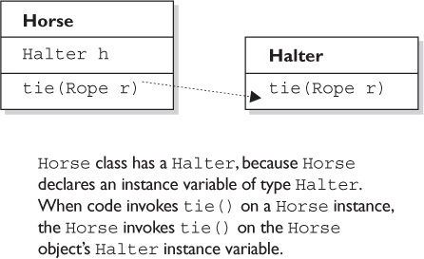
HAS-A Relationships

Slide 83
Polymorphism
Polymorphism is the ability to have multiple forms.
In Java it means:
The ability of a “reference variable” to change it’s behavior according to the kind of object it is holding

Slide 84
Explanation
Consider the following method invocation:
obj.area();
Can you tell whose area( ) method will be called ?
Answer: Depends On Binding!
“Binding” means connecting a method call to a method body.

Slide 85
Types Of Binding
There are two types of binding:
static binding (also known as early binding).
dynamic binding (also known as late binding).

Slide 86
Static Binding
“Static binding” or “early binding” occurs when the compiler can readily determine the correct version of something during compile time, i.e. before the program is executed.
All the static method calls are resolved at compile
time itself and hence we have static binding for static
method calls

Slide 87
Example
class A { static void show() { System.out.println(“Show of A class"); } }
class B extends A { static void show() {
System.out.println(“Show of B class"); } }

Slide 88
Example
class Demo {
public static void main(String[] args) { B b = new B();
b.show();
A a1 = new A(); a1.show();
A a2 = new B(); a2.show(); } }
Output:
Show of B class
Show of A class
Show of A class

Slide 89
Dynamic Binding
“Dynamic binding” or “late binding” occurs when
the compiler determine the correct version of
something during run time.
It is done on the basis of the object pointed by the
reference
All the non-static method calls are resolved at run
time itself and hence we have dynamic binding for them.

Slide 90
Example
class A { public void show() { System.out.println(“Show of A class"); } }
class B extends A { public void show() {
System.out.println(“Show of B class"); } }

Slide 91
Example
class Demo {
public static void main(String[] args) { B b = new B();
b.show();
A a1 = new A(); a1.show();
A a2 = new B(); a2.show(); } }
Output:
Show of B class
Show of A class
Show of B class

Slide 92
Abstract Method
Many times we may not find a suitable implementation for a method in base class .
In such cases java suggests us to declare the method without any body .
The keyword used to do this is abstract.
abstract <return type> <method_name>( );

Slide 93
Properties Of Abstract Method
An abstract method is a method that is declared without an implementation
It just has a method signature
It must reside in an abstract class

Slide 94
Abstract Class
An abstract class is a class that is declared using the keyword abstract
abstract class Vehicle
{ …
}
Abstract classes cannot be instantiated
Abstract classes can be subclassed

Slide 95
Abstract Class
It may or may not include abstract methods
When an abstract class is subclassed, the subclass usually provides implementations for all of the abstract methods in its parent class
If subclass doesn’t provide implementations then the subclass must also be declared abstract.

Slide 96
Example
abstract class Greeting
{
abstract public void greet();
}

Slide 97
Interface
Interfaces don’t have any method implementation.
All methods in an interface are public and abstract.
All data members in an interface are public , static and final

Slide 98
Interface
All methods of an interface should be overridden in a class.
If a class does not override the interface method then the class must be prefixed with the keyword abstract.

Slide 99
Advantages
Interfaces are mainly used to provide polymorphic behavior.
Through interfaces we can implement multiple inheritance .

Slide 100
Syntax Of Interface
interface <name>
{
<data type> <var_name>=<value>;
<return type> <methodname>(<arg>);
}

Slide 101
Example
interface Animal
{
int age=10;
void eat( );
}

Slide 102
Implementing An Interface
class Lion implements Animal
{
public void eat( )
{
System.out.println(“Lion eats flesh”);
}
}

Slide 103
Implementing An Interface
class Cow implements Animal
{
public void eat( )
{
System.out.println(“Cow eats grass”);
}
}

Slide 104
Polymorphism Through Interface
class UseAnimal
{
public static void main(String [ ] args)
{
Animal a=new Lion( );
a.eat( );
a=new Cow( );
a.eat( );
}
}

Slide 105
Extending Interfaces
It’s possible to have an interface extend another interface.
Just like classes, the extended child interface will inherit the abstract methods specified in the parent interface.
interface Vehicle
{
void hasWheels();
void hasEngine();
}
interface Car extends Vehicle
{
void hasDoors();
void hasRoof();
}

Slide 106
Extending Interfaces
Any class which now implements Car will have to override all 4 methods.
References of Vehicle and Car can point to implementation class object.
Using reference of Car we can call all 4 methods but using reference of Vehicle we can call only 2 methods, hasWheels( ) and hasEngine( ).

Slide 107
Abstract Class v/s Interface
Factor | Abstract Class | Interface
Method Body | Can have some methods with definition | Purely abstract and no body at all ( before Java 8 )
Visibility of members | Can be public,private,default or protected | Strictly public
Nature of data members | By default non-static and non-final | Always static and final
Inheritance | Supported via extends keyword | Supported via implements keyword
Multiple Inheritance | Not supported | An interface can extend multiple other interfaces
Constructors | Allowed | Not Allowed
Instantiation | Not Allowed | Not Allowed

Slide 108
Method Overriding
When we extend a class, we can change the behavior of a method in the child class.
This is called method overriding, and this happens when we write in a subclass a method that has the same signature as a method in the parent class.

Slide 109
Rules Regarding Overriding
The argument list must exactly match that of the overridden method. If they don’t match, it becomes method overloading.
The return type must be the same as, or a subtype of, the return type declared in the original overridden method in the superclass.
The access level can’t be more restrictive than that of the overridden method.
The access level CAN be less restrictive than that of the overridden method.

Slide 110
Rules Regarding Overriding
Instance methods can be overridden only if they are inherited by the subclass.
A subclass within the same package as the instance’s superclass can override any superclass method that is not marked private or final.
A subclass in a different package can override only those nonfinal methods marked public or protected (since protected methods are inherited by the subclass).

Slide 111
Rules Regarding Overriding
The overriding method CAN throw any unchecked (runtime) exception, regardless of whether the overridden method declares the exception.
The overriding method must NOT throw checked exceptions that are new or broader than those declared by the overridden method.
For example, a method that declares a FileNotFoundException , cannot be overridden by a method , that declares a SQLException, Exception, or any other non-runtime exception unless it’s a subclass of FileNotFoundException.

Slide 112
Rules Regarding Overriding
The overriding method can throw narrower or fewer exceptions. An overriding method doesn’t have to declare any exceptions that it will never throw, regardless of what the overridden method declares.
We cannot override a method marked final.
We cannot override a method marked static.

Slide 113
Invoking a Superclass Version of an Overridden Method
Often, we’ll want to take advantage of some of the code in the superclass version of a method, yet still override it to provide some additional specific behavior.
It’s easy to do in code using the keyword super as follows:

Slide 114
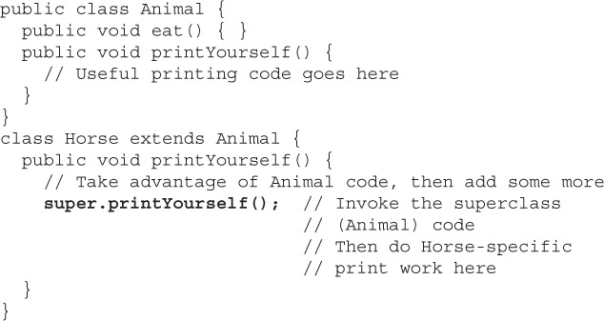
Invoking a Superclass Version of an Overridden Method
:

Slide 115
Invoking a Superclass Version of an Overridden Method
We can use super , only to access a method in a class’ superclass, not the superclass of the superclass
That is, we can’t say super.super.doStuff().

Slide 116
An Important Point
Tell the output :
class A
{
void show() throws Exception
{
System.out.println("In show of A");
}
}

Slide 117
An Important Point
class B extends A
{
void show()
{
System.out.println("In show of B");
}
}
class Demo
{
public static void main(String args[]) {
A obj=new B();
obj.show();
}
}
Syntax Error:
Unreported Exception must be caught or declare to be thrown

Slide 118
Why did the error occurred ?
If we override a method and call it using super type reference pointing to a subtype object, the compiler still thinks we are calling supertype version.
Now if the supertype version declares that it throws some exception and while overriding it the subtype doesn’t declare that then also compiler thinks that we are calling supertype version .
So it generates error if the calling code does not follow “handle or declare rule”

Slide 119
Popular Interview Question
Tell the output :
class A
{
private void show(){
System.out.println("In show of A");
}
}

Slide 120
Popular Interview Question
class B extends A
{
public void show()
{
System.out.println("In show of B");
}
}
class Demo
{
public static void main(String args[]) {
A obj=new B();
obj.show();
}
}
Syntax Error:
show() has private access in A

Slide 121

Are They Legal Overrides ?
Let’s take a look at overriding the eat() method of Animal:

Slide 122
Are They Legal Overrides ?
private void eat( )
No , access modifier is more restrictive
public void eat( ) throws IOException
No, cannot throw a Checked Exception not thrown by the super class method
public void eat(String food)
No, not an overridden method but a legal overload
public String eat()
Not an override because of the return type and not an overload either because there is no change in the argument list

Slide 123
Overloaded Methods
It is possible to declare multiple methods with the same name as long as the parameters vary in type or number or order .
This is called method overloading and can be seen in the implementation of the
System.out.println( ) method.

Slide 124
Overloaded Methods
void myPrint(String s) { System.out.println(s); }
void myPrint(int i) { System.out.println(i); }

Slide 125
Rules Regarding Overloaded Methods
Overloaded methods MUST change the argument list.
Overloaded methods CAN change the return type.
Overloaded methods CAN change the access modifier.
Overloaded methods CAN declare new or broader checked exceptions.

Slide 126
Rules Regarding Overloaded Methods
A method can be overloaded in the same class or in a subclass.
In other words, if class A defines a doStuff(int i)method, the subclass B could define a doStuff(String s) method without overriding the superclass version that takes an int.
So two methods with the same name but in different classes can still be considered overloaded if the subclass inherits one version of the method and then declares another overloaded version in its class definition.

Slide 127
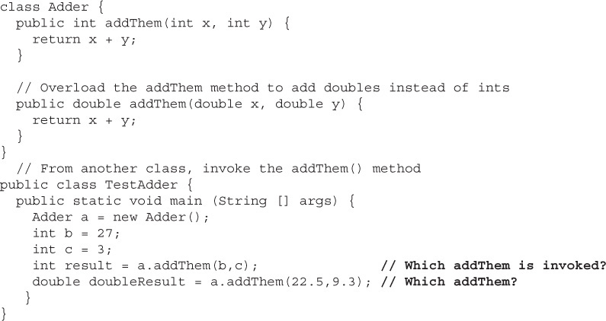
What Is The Output ?
Answer:
For the first call of addThem( ), the int version gets called and for the second call the double version gets called

Slide 128
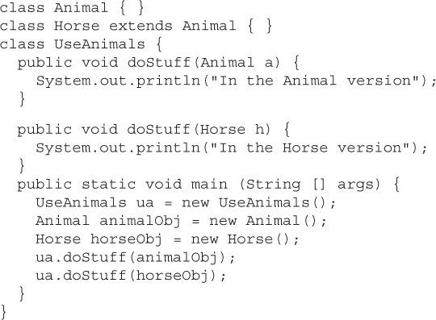
What Is The Output ?
Answer:
In the Animal version
In the Horse Version

Slide 129
What will happen if we you use an Animal reference to a Horse object?
Answer:
In the Animal version

Slide 130
Why did it happen ?
Even though the actual object at runtime is a Horse and not an Animal, but the choice of which overloaded method to call (in other words, the signature of the method) is NOT dynamically decided at runtime.
Just remember that, the reference type (not the object type) determines which overloaded method is invoked!

Slide 131
Summary
To summarize, which overridden version of the method to call (in other words, from which class in the inheritance tree) is decided at runtime based on object type.
But which overloaded version of the method to call is based on the reference type of the argument passed at compile time

Slide 132
Method Overriding V/s Method Overloading
Access Modifiers
Method Overloading: can change
Method Overriding: can change but must not make more restrictive
Return Type
Method Overloading: can change
Method Overriding: can’t change except for covariant types
Exceptions
Method Overloading: can change
Method Overriding: can reduce or even eliminate , but cannot throw new or broader checked exception

Slide 133
Method Overriding V/s Method Overloading
Arguments
Method Overloading: must change
Method Overriding: must not change
Invocation
Method Overloading: reference type determines which overloaded version should run based upon argument types. The actual method that’s invoked is still selected at run time but at compile time the compiler will already know the signature of the method to be invoked
Method Overriding: Object type determines which method is selected and happens at run time

Slide 134
Return Type Declarations
Java has certain rules on what we’re allowed to declare as a return type, which depends primarily on whether we are
overriding
overloading, or
declaring a new method.

Slide 135
Return Types on Overloaded Methods
Method overloading is not much more than name reuse.
The overloaded method is a completely different method from any other method of the same name.
So if we inherit a method but overload it in a subclass, we’re not subject to the restrictions of overriding, which means we can declare any return type we like.

Slide 136
Return Types on Overloaded Methods
What we can’t do is change only the return type.
To overload a method, remember, we must change the argument list. The following code shows an overloaded method:

Slide 137
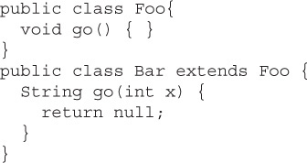
Return Types on Overloaded Methods
The Bar version of the method uses a different return type. That’s perfectly fine. As long as we’ve changed the argument list, we’re overloading the method, so the return type doesn’t have to match that of the superclass version.

Slide 138
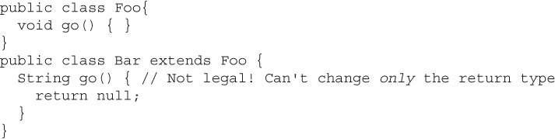
What About This Code ?
Not Legal! Cannot change only the return type!.

Slide 139
Return Types On Overridden Methods
When a subclass wants to change the method implementation of an inherited method (an override), the subclass must define a method that matches the inherited version exactly.
However from Java 5 onwards , java has relaxed the rules regarding return types of overridden methods.
The rule is that we’re allowed to change the return type in the overriding method as long as the new return type is a subtype of the declared return type of the overridden (superclass) method.
This is called “covariant return type”.

Slide 140
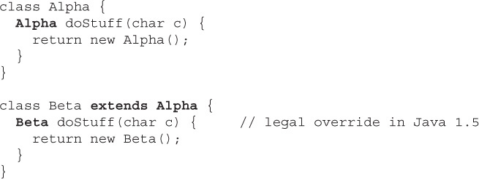
CoVariant Return Type

Slide 141


Rules For Returning A Value
1. We can return null in a method with an object reference return type.
2. An array is a perfectly legal return type.

Slide 142


Rules For Returning A Value
3. In a method with a primitive return type, we can return any value that can be implicitly converted to the declared return type or else we will have to explicitly convert it to method’s return type.

Slide 143
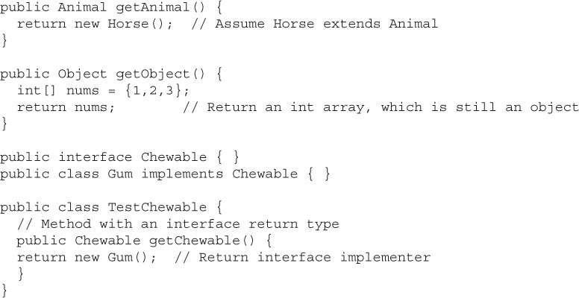
Rules For Returning A Value
4. In a method with an object reference return type, we can return any object type that can be implicitly cast to the declared return type.

Slide 144
Initialization Blocks
Java provides us 3 places to initialize class members:
Explicit Initialization
Constructors
Initialization Blocks

Slide 145
Initialization Blocks
Initialization blocks are of 2 types:
Static Initialization Blocks : which runs when a class is loaded and thus it executes only once
Instance Initialization Blocks: which runs everytime an instance is created

Slide 146
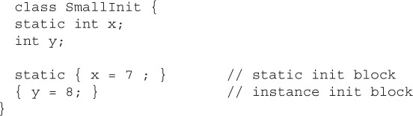
Initialization Blocks

Slide 147
Rules Regarding Initialization Blocks
They don’t have names.
They can’t take arguments.
They don’t return anything.
A static initialization block runs once, when the class is first loaded.
An instance initialization block runs once every time a new instance is created.

Slide 148
Rules Regarding Initialization Blocks
Firstly all static blocks will run.
Then , init blocks execute in the order in which they appear.
If we have a super class then Instance init blocks run after the constructor’s call to super().

Slide 149
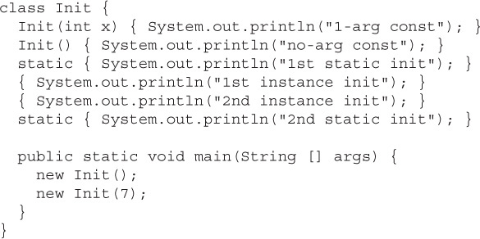
What Is The Output ?

Slide 150
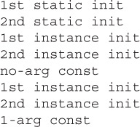
Answer

Slide 151
What Is The Output ?
Exception!
ExceptionInInitializerError
class Demo
{
static int arr[ ]=new int [4];
static
{
arr[4]=10;
System.out.println(arr[0]);
}
public static void main(String [ ] args)
{
}
}

Slide 152
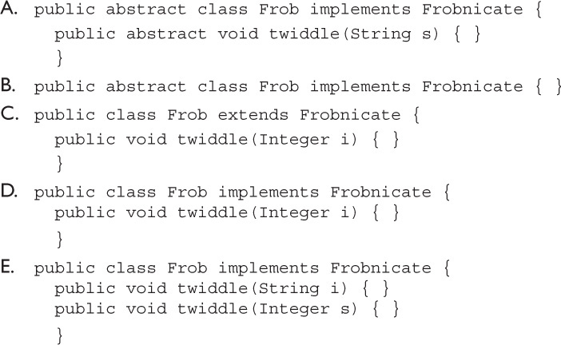
Popular Interview Questions
1. Given:
public abstract interface Frobnicate {
public void twiddle(String s);
}
Which is a correct class? (Choose all that apply.)
Answer:
B & E

Slide 153
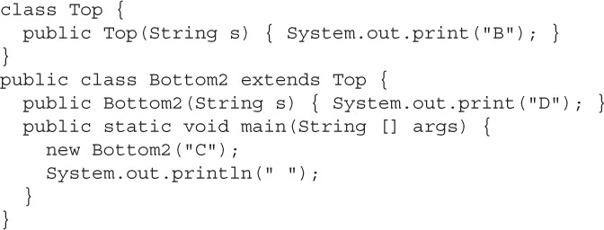
Popular Interview Questions
2. Given:

Slide 154
Popular Interview Questions
What is the result?
A. BD
B. DB
C. BDC
D. DBC
E. Compilation fails
Answer: E

Slide 155
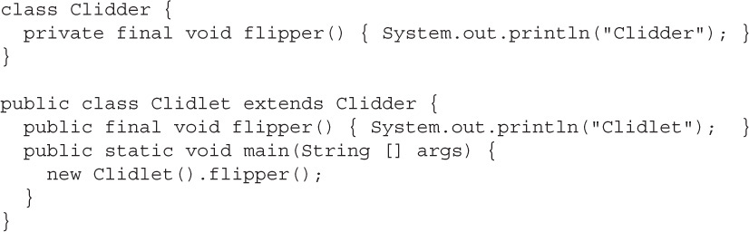
Popular Interview Questions
3.Given

Slide 156
Popular Interview Questions
What is the result?
A. Clidlet
B. Clidder
C. Clidder Clidlet
D. Clidlet Clidder
E. Compilation fails
Answer: A

Slide 157
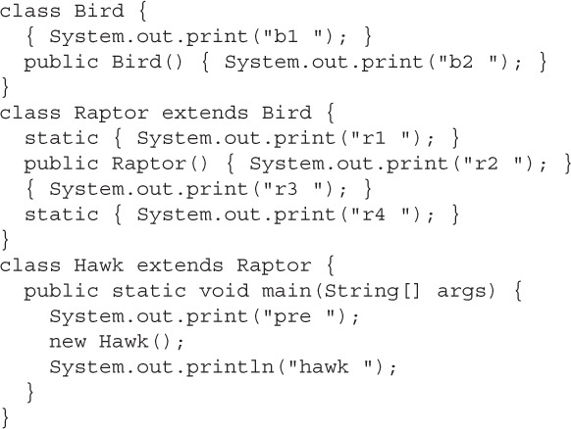
Popular Interview Questions
4.Given

Slide 158
Popular Interview Questions
What is the result?
A. pre b1 b2 r3 r2 hawk
B. pre b2 b1 r2 r3 hawk
C. pre b2 b1 r2 r3 hawk r1 r4
D. r1 r4 pre b1 b2 r3 r2 hawk
E. r1 r4 pre b2 b1 r2 r3 hawk
F. pre r1 r4 b1 b2 r3 r2 hawk
G. pre r1 r4 b2 b1 r2 r3 hawk
H. The order of output cannot be predicted
I. Compilation fails
Answer: D

Slide 159
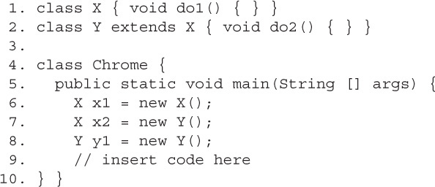
Popular Interview Questions
5.Given

Slide 160
Popular Interview Questions
Which of the following, inserted at line 9, will compile?
(Choose all that apply.)
A. x2.do2();
B. (Y)x2.do2();
C. ((Y)x2).do2();
D. None of the above statements will compile
Answer: C

Slide 161
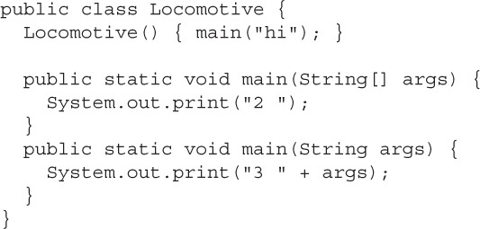
Popular Interview Questions
6.Given

Slide 162
Popular Interview Questions
What is the result? (Choose all that apply.)
A. 2 will be included in the output
B. 3 will be included in the output
C. hi will be included in the output
D. Compilation fails
E. An exception is thrown at runtime
Answer: A

Slide 163
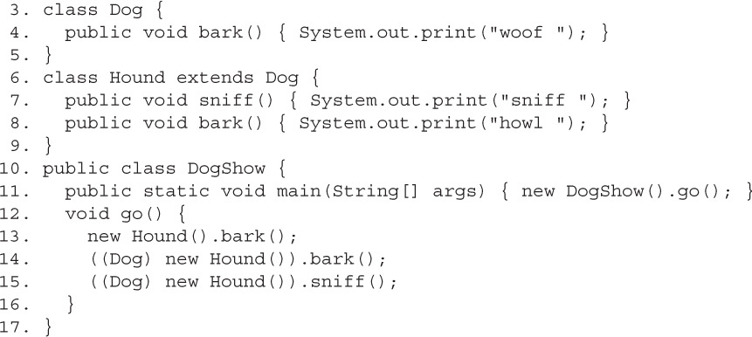
Popular Interview Questions
7.Given

Slide 164
Popular Interview Questions
What is the result? (Choose all that apply.)
A. howl howl sniff
B. howl woof sniff
C. howl howl followed by an exception
D. howl woof followed by an exception
E. Compilation fails with an error at line 14
F. Compilation fails with an error at line 15
Answer: F

Slide 165
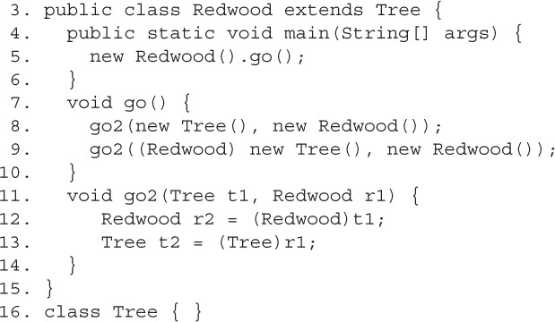
Popular Interview Questions
8.Given

Slide 166
Popular Interview Questions
What is the result? (Choose all that apply.)
A. An exception is thrown at runtime
B. The code compiles and runs with no output
C. Compilation fails with an error at line 8
D. Compilation fails with an error at line 9
E. Compilation fails with an error at line 12
F. Compilation fails with an error at line 13
Answer: A

Slide 167
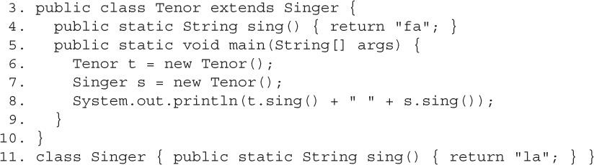
Popular Interview Questions
9.Given

Slide 168
Popular Interview Questions
What is the result? (Choose all that apply.)
A. fa fa
B. fa la
C. la la
D. Compilation fails
E. An exception is thrown at runtime
Answer: B

Slide 169
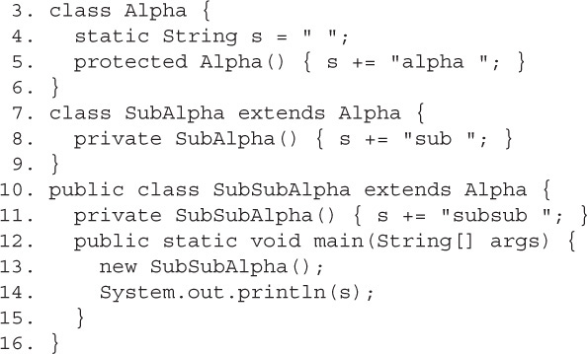
Popular Interview Questions
10.Given

Slide 170
Popular Interview Questions
What is the result? (Choose all that apply.)
A. subsub
B. sub subsub
C. alpha subsub
D. alpha sub subsub
E. Compilation fails
F. An exception is thrown at runtime
Answer:C

Slide 171
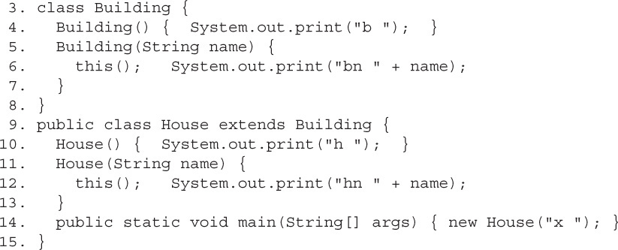
Popular Interview Questions
11.Given

Slide 172
Popular Interview Questions
What is the result? (Choose all that apply.)
A. h hn x
B. hn x h
C. b h hn x
D. b hn x h
E. bn x h hn x
F. b bn x h hn x
G. bn x b h hn x
H. Compilation fails
Answer:C

Slide 173
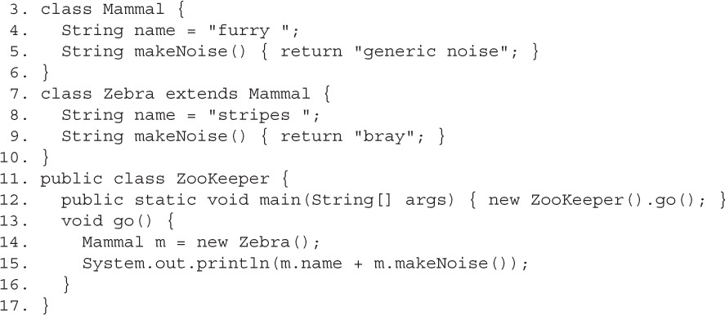
Popular Interview Questions
12.Given

Slide 174
Popular Interview Questions
What is the result? (Choose all that apply.)
A. furry bray
B. stripes bray
C. furry generic noise
D. stripes generic noise
E. Compilation fails
F. An exception is thrown at runtime
Answer:A

Slide 175
Popular Interview Questions
13. You’re designing a new online board game in which Floozels are a type of Jammers, Jammers can have Quizels, Quizels are a type of Klakker, and Floozels can have several Floozets.
Which of the following fragments represent this design?
(Choose all that apply.)

Slide 176
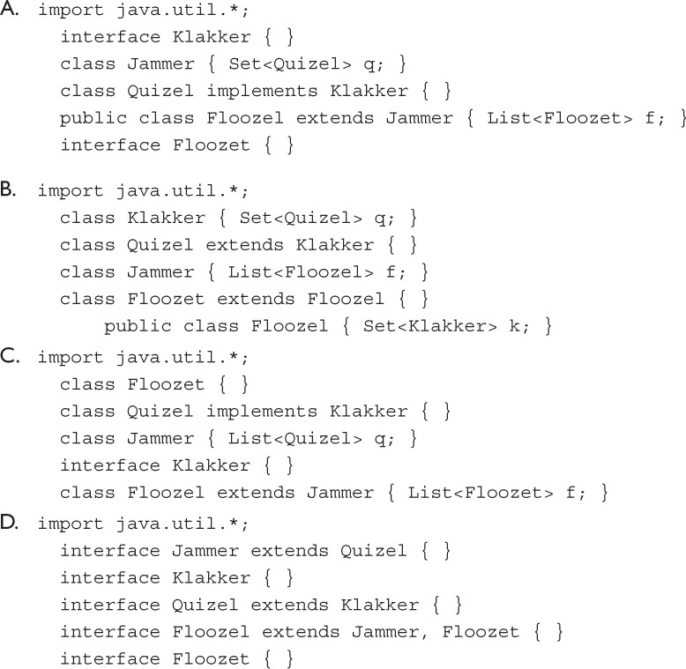
Popular Interview Questions
Answer:
A & C

Slide 177
Popular Interview Questions
14 .How can you include encapsulation in your class design?
(Choose all that apply)
A. Define instance variables as private members.
B.Define public methods to access and modify the instance variables.
C.Define some of the instance variables as public members.
D.All of the above.
Answer: A & B

Slide 178
Popular Interview Questions
15 . Examine the following code and select the correct option(s):
public class Person {
public int height;
public void setHeight(int newHeight) {
if (newHeight <= 300)
height = newHeight;
}
}

Slide 179
Popular Interview Questions
A. The height of a Person can never be set to more than 300.
B. The previous code is an example of a well-encapsulated class.
C. The class would be better encapsulated if the height validation weren’t set to 300.
D. Even though the class isn’t well encapsulated, it can be inherited by other classes.
Answer: D

Slide 180
Popular Interview Questions
16 . Which of the following methods correctly accepts three whole numbers as method arguments and returns their sum as a decimal number?
public void addNumbers(byte arg1, int arg2, int arg3) { double sum = arg1 + arg2 + arg3; }
public double subtractNumbers(byte arg1, int arg2, int arg3) { double sum = arg1 + arg2 + arg3; return sum; }

Slide 181
Popular Interview Questions
C public double numbers(long arg1, byte arg2, double arg3) { return arg1 + arg2 + arg3; }
D.public float wakaWakaAfrica(long a1, long a2, short a977) { double sum = a1 + a2 + a977; return (float)sum; }
Answer: B & D

Slide 182
Popular Interview Questions
17 . Which of the following statements are true?
A. If the return type of a method is int, the method can return a value of type byte.
B. A method may or may not return a value.
C. If the return type of a method is void, it can define a return statement without a value, as follows: return;
D. A method may or may not accept any method arguments.
E. A method should accept at least one argument or define its return type.
F. A method whose return type is String can’t return null.
Answer: A,B,C,D

Slide 183
Popular Interview Questions
18 . Given the following definition of class Person,
class Person {
public String name;
public int height;
}
What is the output of the following code?

Slide 184
Popular Interview Questions
class Demo
{
public static void main(String args[]) {
Person p = new Person();
p.name = "EJava";
anotherMethod(p);
System.out.println(p.name);
someMethod(p);
System.out.println(p.name);
}

Slide 185
Popular Interview Questions
static void someMethod(Person p) {
p.name = "someMethod";
System.out.println(p.name);
}
static void anotherMethod(Person p) {
p = new Person();
p.name = "anotherMethod";
System.out.println(p.name);
}
}

Slide 186
Popular Interview Questions
A. anotherMethod anotherMethod someMethod someMethod
B.anotherMethod EJava someMethod someMethod
C.anotherMethod EJava someMethod EJava
D. Compilation error.
Answer:B

Slide 187
Popular Interview Questions
19 . Given the following signature of method eJava, choose the options that correctly overload this method:
public String eJava(int age, String name, double duration)
A. private String eJava(int val, String firstName, double dur)
B. public void eJava(int val1, String val2, double val3)
C. String eJava(String name, int age, double duration)
D. float eJava(double name, String age, byte duration)
E. ArrayList<String> eJava()
F. char[] eJava(double numbers)
G. String eJava()
Answer: C,D,E,F,G

Slide 188
Popular Interview Questions
20 . Select the incorrect options:
A.If a user defines a private constructor for a public class, Java creates a public default constructor for the class.
B. A class that gets a default constructor doesn’t have overloaded constructors.
C. A user can overload the default constructor of a class.
D. The following class is eligible for default constructor: class EJava {}
E. The following class is also eligible for a default constructor: class EJava { void EJava() {} }
Answer: A,C

Slide 189
Popular Interview Questions
21 . Given the following code,
class Course {
void enroll(long duration) {
System.out.println("long");
}
void enroll(int duration) {
System.out.println("int");
}
void enroll(String s) { System.out.println("String");
}
void enroll(Object o) { System.out.println("Object");
}
}

Slide 190
Popular Interview Questions
What is the output of the following code?
class Demo {
public static void main(String args[]) {
Course course = new Course();
char c = 10;
course.enroll(c);
course.enroll("Object");
}
}
A.Compilation error
B.Runtime exception
C.int String
D.long Object
Answer: C

Slide 191
Popular Interview Questions
22 . Examine the following code and select the correct options:
class EJava {
public EJava() {
this(7);
System.out.println("public");
}
private EJava(int val) {
this("Sunday");
System.out.println("private");
}
protected EJava(String val) {
System.out.println("protected");
}
}
class TestEJava { public static void main(String[] args) {
EJava eJava = new EJava(); } }

Slide 192
Popular Interview Questions
A.The class EJava defines three overloaded constructors.
B. The class EJava defines two overloaded constructors. The private constructor isn’t counted as an overloaded constructor.
C. Constructors with different access modifiers can’t call each other.
D. The code prints the following: protected private public
E.The code prints the following: public private protected
Answer: A & D

